Slide 1
Lecture 5: Case Study for Linear Regression
Instructor: Xiaobai Liu

Slide 2
Outline
Project 1: Synthetic DataSet
Project 2: Housing Dataset

Slide 3
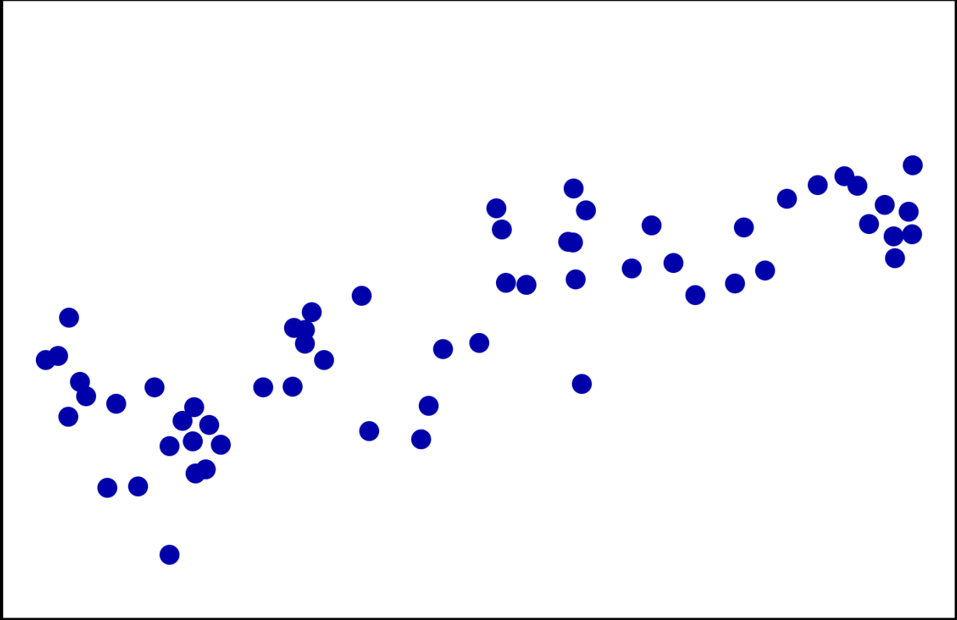
Project 1: Synthetic Dataset
A single input feature and a continuous target variable (or output)
Output
Feature

Slide 4
Project 1: outline
Load dataset
Visualization
Data splitting
Training
Predictions
Evaluations

Slide 5
Project 1: outline
Load dataset
Visualization
Data splitting
Training
Predictions
Evaluations

Slide 6
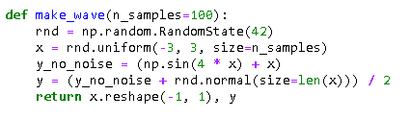
Load dataset
Generate a set of data points (x, y), where x is the input and y is the output
Built-in functions: rnd.uniform()

Slide 7
Project 1: outline
Load dataset
Visualization
Data splitting
Training
Predictions
Evaluations

Slide 8

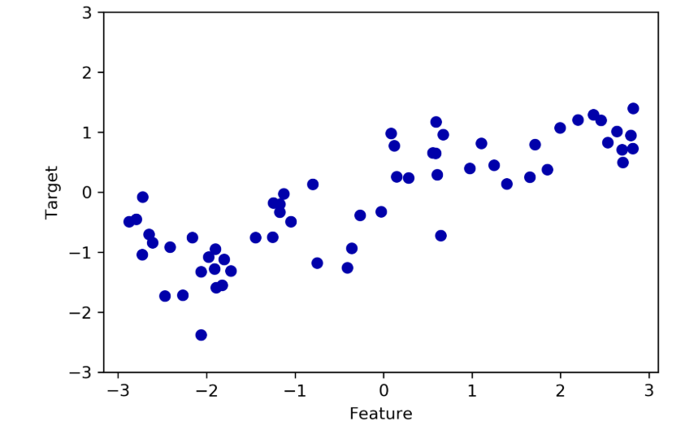
Visualization
Plotting all the data points in a 2-D figure

Slide 9
Project 1: outline
Load dataset
Visualization
Data splitting
Training
Predictions
Evaluations

Slide 10
Data Splitting
Partition the dataset into two subsets: used for training and testing, respectively.

Slide 11
Project 1: outline
Load dataset
Visualization
Data splitting
Training
Predictions
Evaluations

Slide 12
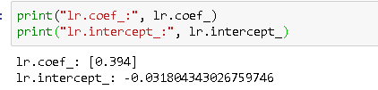
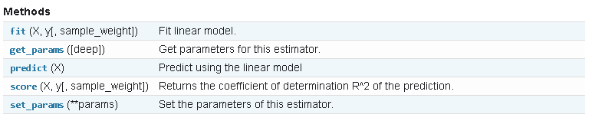
Training
Utilize the library sklearn.linear_model LinearRegression class

Slide 13
Project 1: outline
Load dataset
Visualization
Data splitting
Training
Predictions
Evaluations

Slide 14
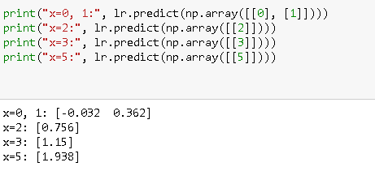
Predictions
Predictions over individual data points

Slide 15
Project 1: outline
Load dataset
Visualization
Data splitting
Training
Predictions
Evaluations

Slide 16
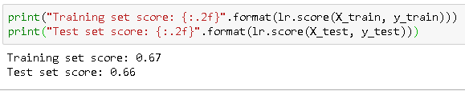
Evaluations
Make prediction on every testing data point, compare to its ground-truth value, and calculate the average error

Slide 17
Project 1: summary
Load dataset
Visualization
Data splitting
Training
Predictions
Evaluations

Slide 18
Project 2: Housing Dataset
Boston Housing dataset
To predict the median value of homes in several Boston neighborhoods
Feature predictors: crime rate, proximity to the Charles River, highway accessibility, etc.
506 data points, 13 features

Slide 19
Project 2: Outline
Load dataset
Visualization
Data splitting
Training
Predictions
Evaluations

Slide 20
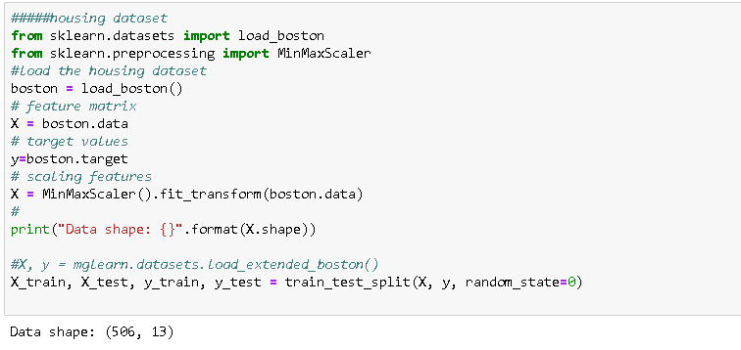
Load and split dataset
Sklearn provides a built-in access to this dataset

Slide 21
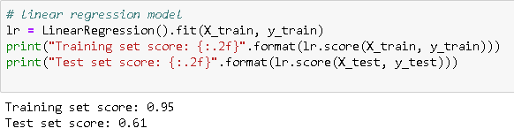
Training and evaluations

Slide 22
Summary
Project 1: Synthetic DataSet
Project 2: Housing Dataset

